Slide 1


Slide 2
What is node.js?

Slide 3
Main Goal
To provide a purely evented, non-blocking infrastructure to
script highly concurrent programs.

Slide 4
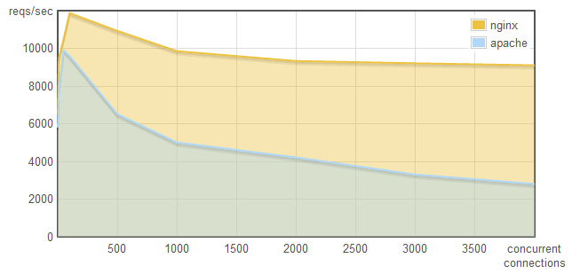
Apache vs NGINX
concurrency × reqs/sec

Slide 5
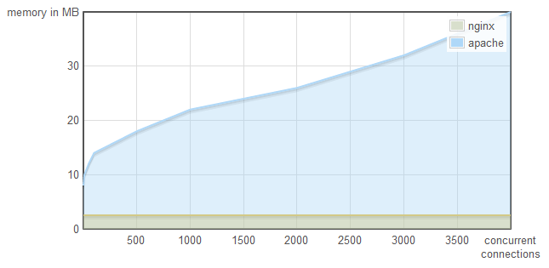
Apache vs NGINX
concurrency × memory

Slide 6
Design Goals

Slide 7
Benchmarks
nginx v0.7.65 node v0.1.91
tornado v0.2 (python 2.6.4) thin v1.2.7 (ruby 1.9.1-p376)
●
●
●
●
In Linux using a Intel Core 2 Due 2.53, 4 GB memory

Slide 8
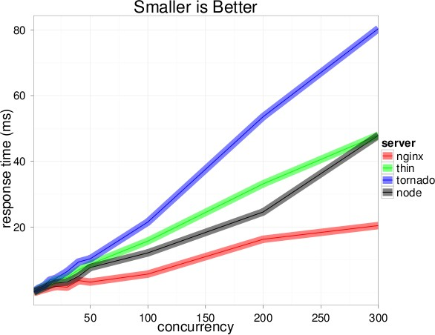

Slide 9
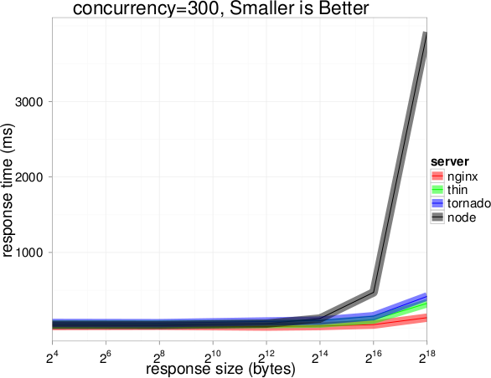

Slide 10
Wow. Node sucks at serving large files.
Well over 3 second responses for 256 kilobyte files at 300 concurrent connections.

Slide 11
What’s happening:
V8 has a generational garbage collector. Moves objects around randomly.
Node can’t get a pointer to raw string data to write to socket.

Slide 12
Using Node’s new Buffer object, the results change.

Slide 13
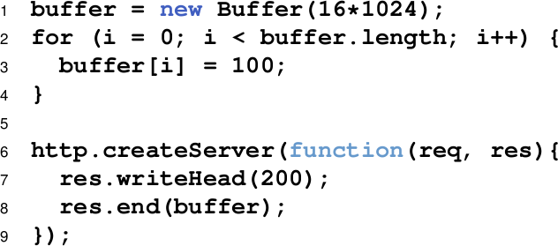

Slide 14
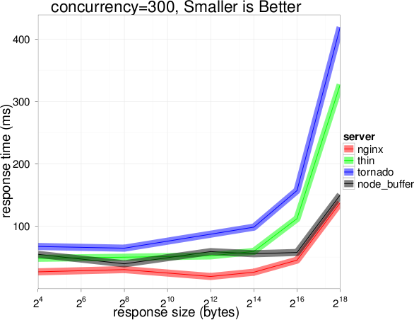

Slide 15
Installation
https://github.com/joyent/node/wiki/Installation

Slide 16
THANK YOU ☺

